Slide 1
Kubota Kubota Sync & Remote Service
KvG Mechatronics
Season 2025

Slide 2
Table of Contents
Product Portfolio
Remote Support
Connectivity
IsoMatch FarmCentre
Kubota Sync

Slide 3
Company Presentation
KvG Mechatronics
Season 2024-25

Slide 4
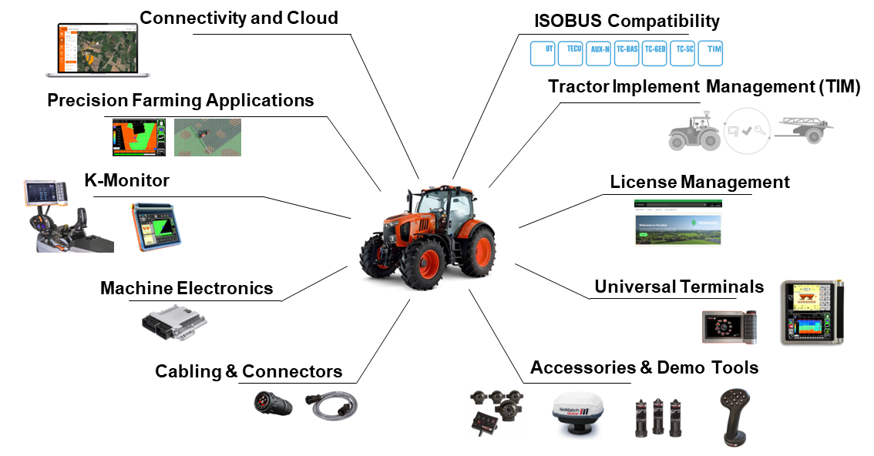
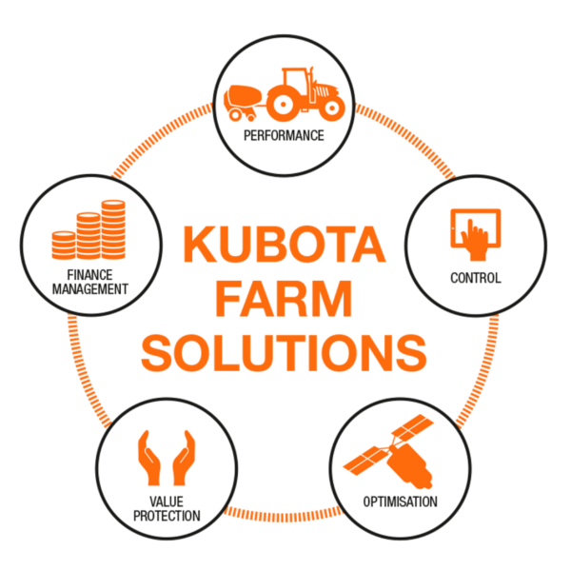
Kubota Farm Solutions
A complete eco-system

Slide 5
New Approach
Remote Service
Remote Service
Aimed at all kind of professionals.
Dedicated to current implements.
Clear UI and easy to use UX.
Only relevant features.
Dedicated tools will not be included.
Remote connection.
Linked to K-OBD ACE.
IsoMatch TopService
Aimed at highly qualified professionals.
Old developments legacy.
Unstructured UX.
Non relevant features.
One-for-all concept.
Limited to physical connection.
Lifetime license.

Slide 6
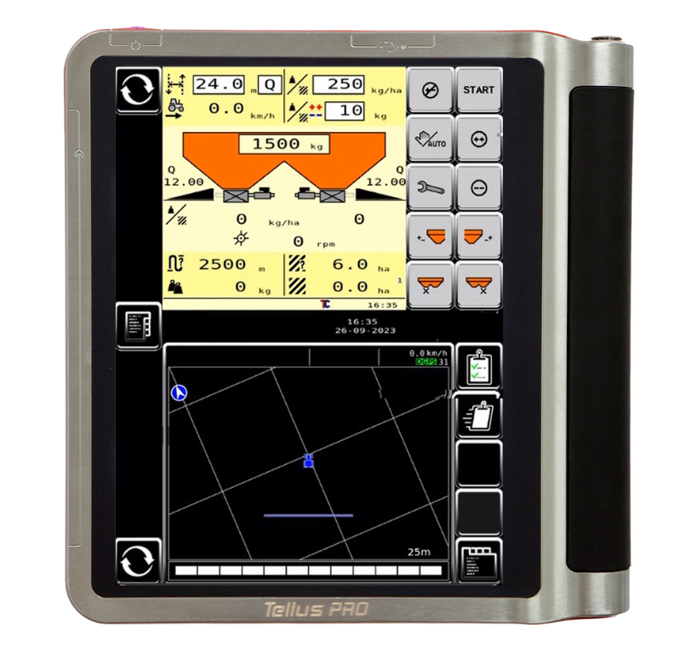
Functionalities
Remote Service
The most important feature we have added to this tool is the possibility to connect remotely to the implements. But there are other features, like the sensors tracing or the possibility to use tablets or cell phones devices to connect to an implement. All in all, Remote Service represents a huge improvement over IsoMatch TopService.
Comparison of functionalities
i

Slide 7
Summary of Functionalities
Remote Service
CONNECTION | Software Update | Can Log | Parameters and SOV | Errors, Events and DTC | Sensor I/O | Remote Terminal
REMOTE | No | Yes | Yes | Yes | Yes | Yes*
USER LEVELS | Changes Allowed
DEALER | Green Param.
REPRESENTATIVE | Blue Param.
FACTORY | Red Param.
* Remote Terminal is not supported when the connection is with a Kubota Sync Gateway

Slide 8

Remote Connection (Terminal)
Remote Service
New Remote Service functionality
With Remote Service it is possible to connect remotely to an implement in the field.
Customer side
Go to the Remote Service App.
Click Remote Service to Request an ID.
Accept and agree the connection conditions.
A 6-digit code will be facilitated.
Share the code with the technician.
Accept the connection.
Technician side side
Open the Remote Service tool in your K-OBD ACE service tool.
Click CONNECT REMOTELY on the left menu.
Type the code shared by the customer.

Slide 9
Remote Connection (Kubota Sync)
Remote Service

Slide 10
Remote Connection (Kubota Sync)
Remote Service

Slide 11
Remote Connection (Kubota Sync)
Remote Service

Slide 12
Remote Connection (Kubota Sync)
Remote Service

Slide 13
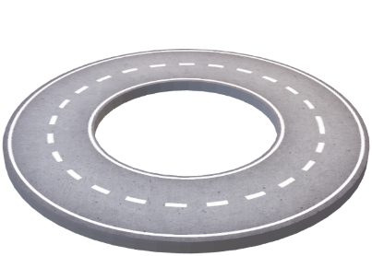
Unique Characteristics
Remote Service11
Parameters
Data
01
02
03
Remote Terminal
Which are the features?
Simplicity has played a crucial role in the evolution of Remote Service. However, this doesn't imply that the tool lacks numerous features that significantly enhance its usability and functionality compared to IsoMatch TopService. Remote Service's features are categorized into three distinct sections.

Slide 14
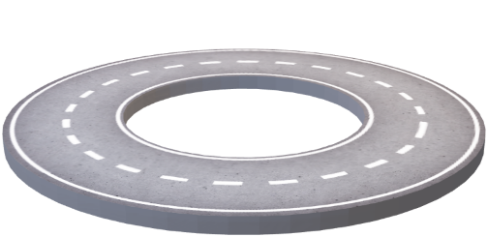
Remote Terminal
Remote Service22
Remote Terminal
Enable the dealer/service to view the screen of the farmer’s terminal located remotely
The Remote Terminal enables users to mirror their screen onto their computer. However, it restricts interaction due to significant safety risks.
01
02
03

Slide 15
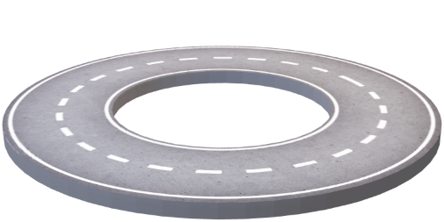
Parameters of Implements
Remote Service33
Parameters
Technicians can read, change, save and send back implement’s parameters
This functionality will allow to modify parameters of the implement remotely and with physical connection. Depending on the level of access to the service tool, the technician will be able to modify some parameters while others will be blocked.
01
02
03

Slide 16
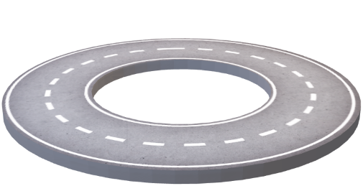
Data of Implements
Remote Service44
Some of the data we can collect are DTCs (Device Trouble Codes), Error Codes and SOVs (Standard Operational Values). In all cases the active events or history events can be checked and saved. Also, the implement’s Input and Output status can be tracked on the go and it will be also possible to create remote CAN logs of the system.
Data
Data generated by the implements will be monitored and can be downloaded for further analysis
01
02
03

Slide 17
Phase in & Phase out
Remote Service
Remote Service
Remote Service has been released on August 13th, 2024. The application is available in the Company Portal.
From September 2024 it will be available for dealers who join the Dealer’s Digital Package program.
A dedicated set of connection hardware will be released in November 2024.
IsoMatch TopService
IsoMatch TopService will be supported until August 31st, 2025.
From September 1st, 2025, implement’s software database will not be updated anymore
Hardware delivered with IsoMatch TopService is compatible with Remote Service, so no new hardware has to be purchased for existing users.

Slide 18
Connectivity
KvG Mechatronics
Season 2025

Slide 19
Table of Contents
Connectivity
IsoMatch FarmCentre
Kubota Kubota Sync

Slide 20
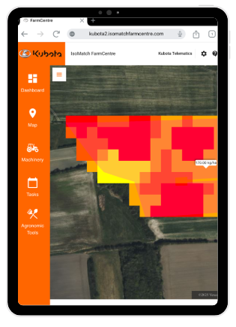
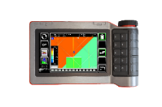
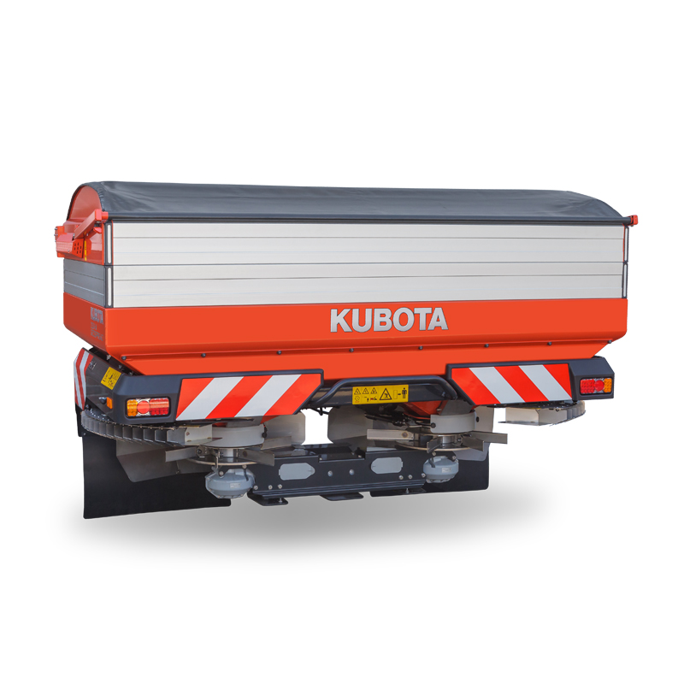
Why Connectivity?
IsoMatch FarmCentre
To keep increasing machines & crops efficiency
Data and
Analytics
Electronics
and Software
Mechanics
Optimization
IsoMatch FarmCentre integrated with in-house electronics.
Precision
Kverneland Group – ISOBUS electronics lead.
Quality
KvG – premium implements brand

Slide 21
System Overview
IsoMatch FarmCentre
Why?
How?
What?
Our customers need an easy way to track farming operations, plan tasks with variable rate maps and remotely monitor the fleet. To be their preferred supplier we need to provide solutions to this challenges.
By supplying a connectivity system to help the users to manage and control their fleet and the tasks performed.
IsoMatch FarmCentre is a connectivity platform which uses in-house gateways to connect terminals, terminals and tractors. A simple user interface brings efficiency to operations control having all information in the same place.

Slide 22
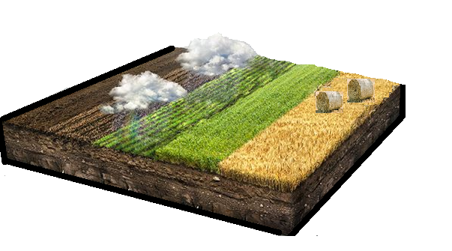
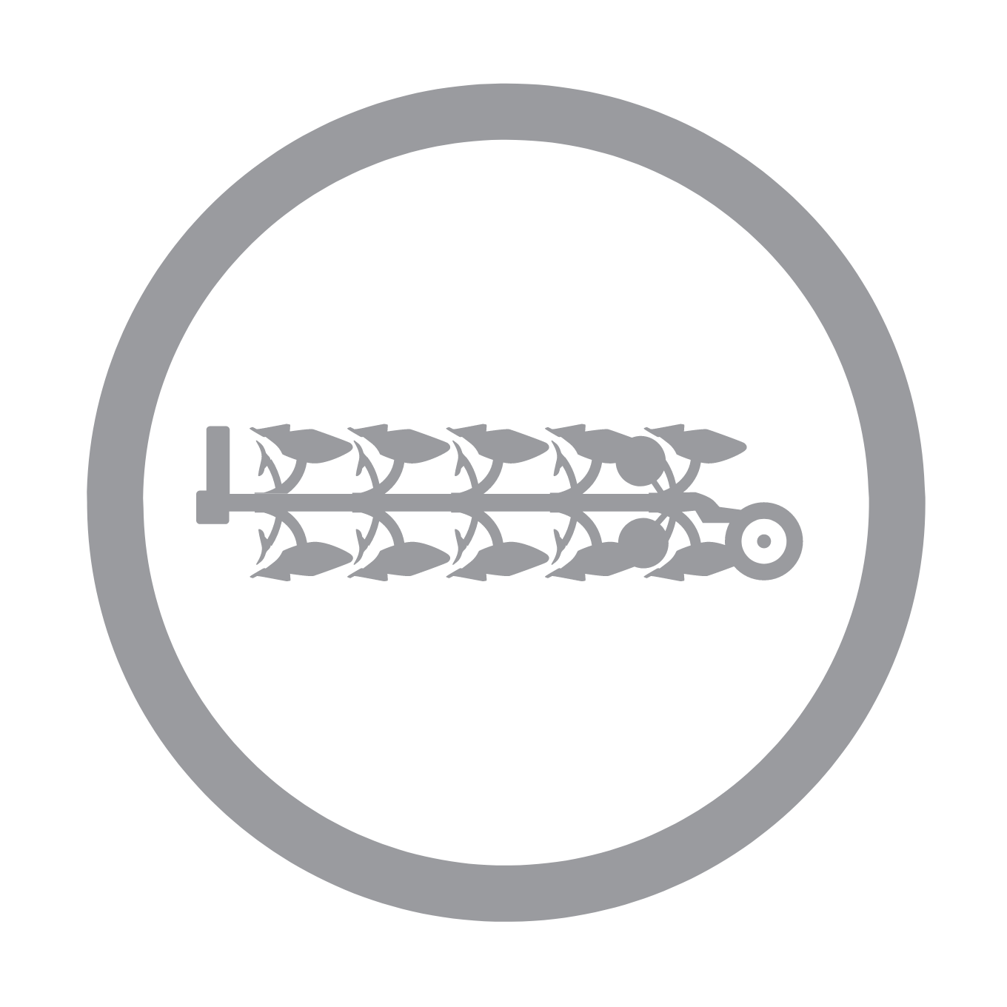

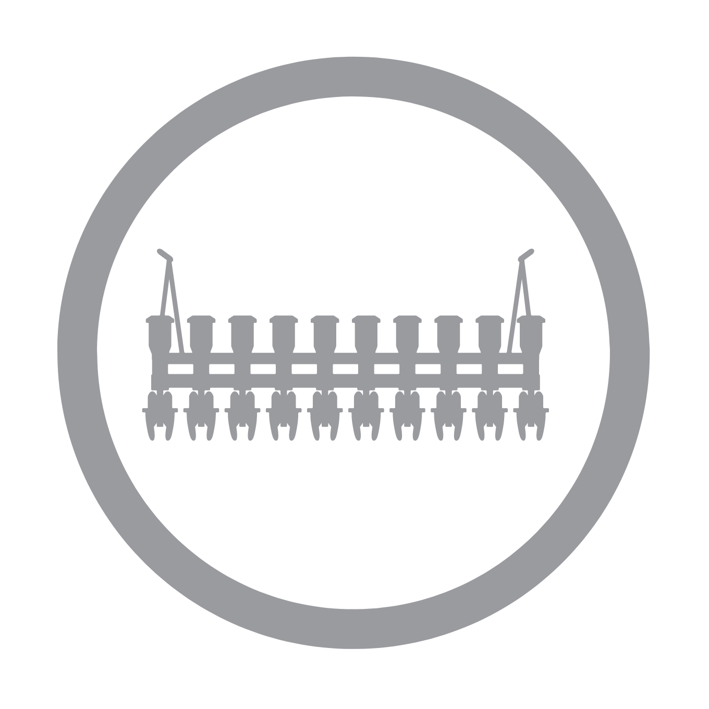





Digitalization: 360º Vision
“Become more precise, autonomous, digital, and drive the reduction of inputs and impact on the environment.”
IsoMatch FarmCentre
Data Storage
Field history
Soil Sampling
Remote Sensing
Decision making tools
Data exchange with suppliers, advisors
Prescription maps
Weather forecast
Yield Mapping
Ploughing
Cultivation
Seeding
Baling
Sprayer
Raking
Fertiliser
Mowing

Slide 23
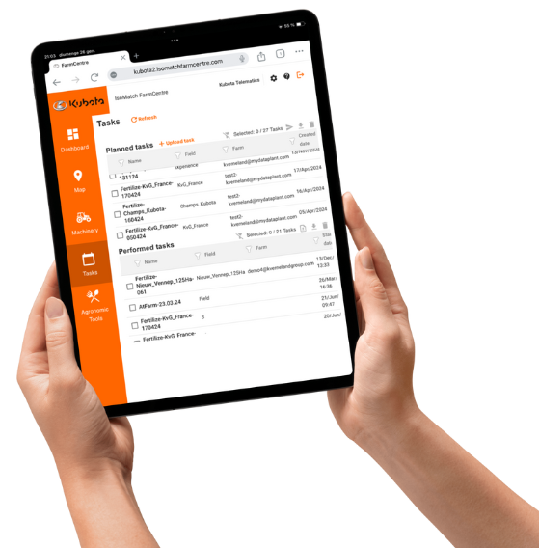
Manage Your Fleet
IsoMatch FarmCentre
IsoMatch FarmCentre is the first of a series of telematics solutions. If you wish to control your fleet, manage tasks remotely or analyse machine performance data, IsoMatch FarmCentre provides this in a web application, linking implements, tractors and terminals in one continuous flow of data and connectivity.

Slide 24
Cloud Connection
IsoMatch FarmCentre

Slide 25
Optimize Implements
IsoMatch FarmCentre
Intuitive, Connected, Sustainable
Telematics solution for Optimized Machinery and Fleet Management, suitable for Kverneland, Vicon and Kubota ISOBUS machines and Kubota tractors.
Machinery Control
Wireless Tasks Exchange
Agronomic Tools
Analytics & Reports

Slide 26
Key Strengths
IsoMatch FarmCentre
Connected Machinery
Machinery monitoring
Data Storage
Terminals
Outputs
Streamlined Services
Terminals
Implements
Tractors
Task data exchange
API connections
Implements
Vehicles
Tracking, SOVs, DTCs
Taskdata
Customer data
Fleet control
Task performance
Task optimization
Taskdata exchange
Analytics-reports
MyDataPlant
Integrations

Slide 27

Data Shared and Collected
IsoMatch FarmCentre
SOVs
01
02
DTCs
Standard Operational Values are the parameters related to the implement performance and task controller. For instance, amount of ha, ha per hour, kg per ha, or operative sections.
Diagnostics Trouble Codes are what we commonly name alarms. They are not only related to technical issues but to the day-to-day, like empty hopper, or recurring maintenance.
Task data
03
04
Database
By sending tasks remotely to IM GEOCONTROL, users avoid having to use USB sticks. Operators can receive tasks and report them once finished even when they are in the field.
All data are stored in a secure server and can be extracted for further analysis. Big data is a key factor to succeed in further implement and system developments.

Slide 28
Exclusive Features
IsoMatch FarmCentre
All-in-one
With an easy and clean design.
Track every detail
In the system, from alerts to machine performance.
Supports decision making
With smart reporting.
Full overview
All details in once place wherever you are.
Collaborative system
With external partnerships.
Optimize farm
operations
By being connected.

Slide 29
Use Cases
IsoMatch FarmCentre
Map
Implement location
Implement status
Machinery inventory
Tasks and notifications
Tasks
Machinery usage
Reports
Dashboard Overview
Map
Geofence
Path track
Machine status & setup
Analytics
Machine Monitoring
Implement performance
By time frame
By parameter
Cross parameters
Notifications and Alerts
Tasks Remote Exchange
IM FarmCentre to terminal
Terminal to IM FarmCentre
!
Agronomic
Tools
Geofence
Errors
Troubles
Others
MyDataPlant
FMIS
Satellite Imagery
VR maps

Slide 30
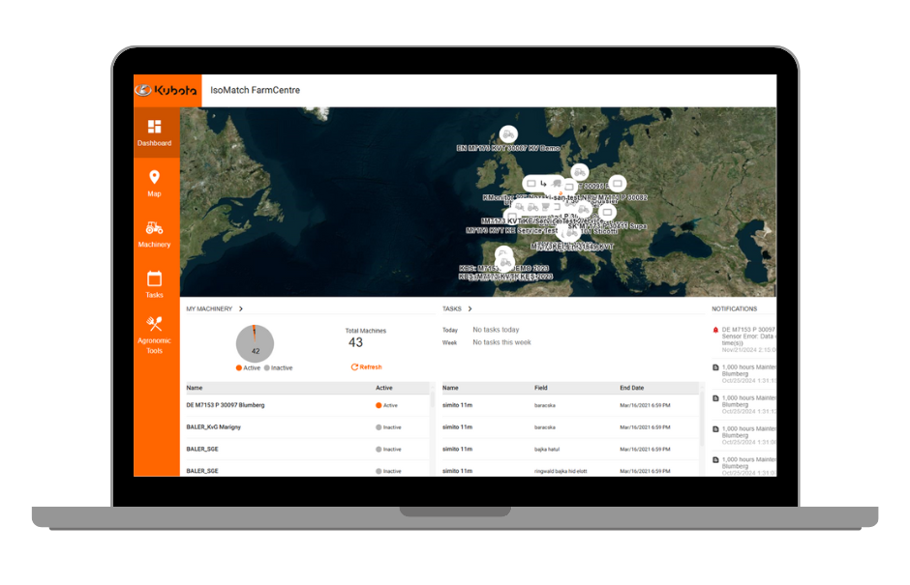
IsoMatch FarmCentre
Fleet management for renting services
Owners of KvG, connected machinery.
Contractor – TBD.
Cooperative renting fleet.
Ag Machinery dealer.
Real-time machine location.
Usage statistics.
Real-time machine SOVs monitoring.
SOVs record for analytics.
Farmer side – ability to rent specific machinery which is always up to date; knowledge that machines are connected will avoid bad usages; pay per use lowers risk. Machinery owner side – machines working more hours and creating continuous revenue, ability to receive feedback from users and SOVs to monitor usage.
Pay per use (rent for punctual/seasonal needs).
Up to date maintenance.
Remote machinery control.
Machine makes usage.

Slide 31
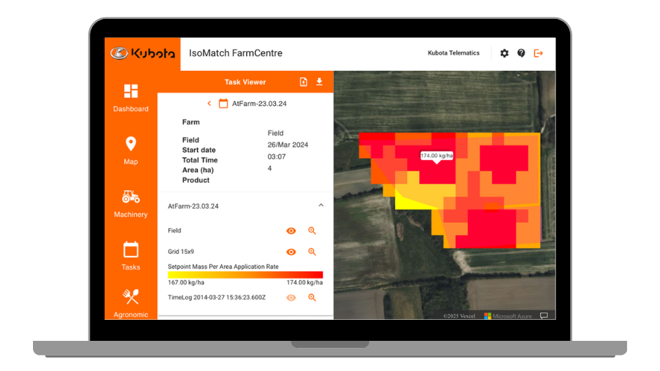
IsoMatch FarmCentre
Variable Rate Management
Owners of KvG connected machinery
Farmer
Contractor
Agronomist
Satellite imagery by field.
VR maps based on biomass.
ISOXML Taskdata file.
Variable Rate map tool is available with IsoMatch FarmCentre license.
Once field boundaries are introduced into the platform then the application automatically calculates biomass maps based on satellite imagery. .
End user is free to choose the map that better fits his field variability and it can be directly and wireless sent to KvG connected terminals.
Optimize chemical input applications (seeds, fertilizer and pesticides).
The simplest & quickest VR maps creation.
Integrated with KvG machinery.

Slide 32



Benefits
IsoMatch FarmCentre
Farmers
Fleet and Crops optimization
Controlled machinery usage.
Optimized inputs (pesticides…) application.
Reduced time on task data transfer
Easy to use platform integrated
Dealers
Sales increased value
Easy and clean platform for Machinery and Agronomy optimization.
Task data compatibility (isoxml).
Connected to 3rd party systems.

Slide 33
Data analytics: The Target
IsoMatch FarmCentre
Match designed use of a component to actual usage, give advise and alert based on over usage/under utilisation/setup
Uptime Guarantee
1
Improve productivity and uptime of implements
Machine
optimisation
2
Allow farmers to customise the graphs and crossing of parameters
Fuel consumption per bale, hours per hectare
Complexity
Cross parameters
Value
3
Improved graphs and visualisations
One dimensional data
Hectares, hours worked,
Fuel consumption etc.
4
Current situation
Reporting of parameters
Visualise information in a table

Slide 34
Application Access
IsoMatch FarmCentre
To access the IsoMatch FarmCentre application, customers must register on the MyKverneland or MyVicon websites or in the Kubota IsoMatch FarmCentre site. In doing so they will accept the terms and conditions of the application regarding the use of private data.

Slide 35
Complete Package
IsoMatch FarmCentre
The IsoMatch FarmCentre package includes a 4G dongle with a SIM card, a cable for easy installation in the terminal, a quick installation guide and the code to activate the corresponding licence, valid for two years. Licence includes the data for the supplied SIM card which will be active if the corresponding IsoMatch FarmCentre licence is active.

Slide 36
Implement Readiness
IsoMatch FarmCentre
Implement type | Kubota | Software
Variable Baler | BF32xx | BALER_SGE
 | BF3500
 | BV4xxx
 | BV5xxx
 | BV6160
 | BV6190
Bale wrapper combination (non-stop) | FB 1000 Premium | FASTBALE
Butterfly Mower Conditioner | DMC63100 | ISOMOCO
 | DMC64100
Disc Spreaders | DSM-W GEOSPREAD | EDW2
 | DSX-W GEOSPREAD
 | DSXL-W GEOSPREAD
 | DSM-W GEOSPREAD | EDW3
 | DSX-W GEOSPREAD
 | DSXL-W GEOSPREAD
 | DSM-W GEOSPREAD | EDW4
 | DSX-W GEOSPREAD
 | DSXL-W GEOSPREAD

Slide 37
Implement Readiness
IsoMatch FarmCentre
Implement type | Kubota | Software
Mounted Sprayer | XMS 2 | iXspray
Trailed Sprayer | XTS 3
 | -----
 | -----
Universal Seeder | SC | E_COM_UD
Seed Drill | TD | E_COM_SINGLE
 | SD3000
 | SH1600
Precision Planter | PP | E_DRIVE2
Mounted Ploughs | ----- | MRP_ISO
Trailed Cultivator | ----- | CULTI_T

Slide 38




Support
IsoMatch FarmCentre
Operators Manual
To download from the website in PDF format
How to videos
Available in Youtube
Training material
Specific content
On demand webinars
Knowledge & Service Centre
Internal support

Slide 39
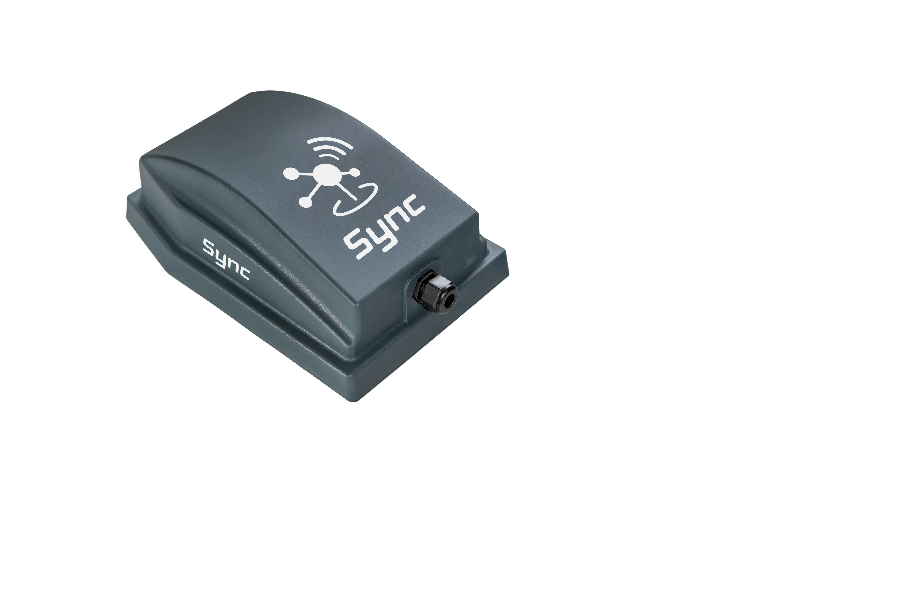
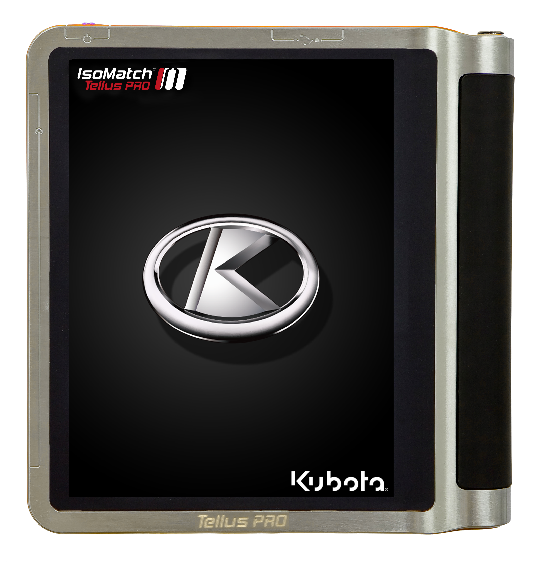
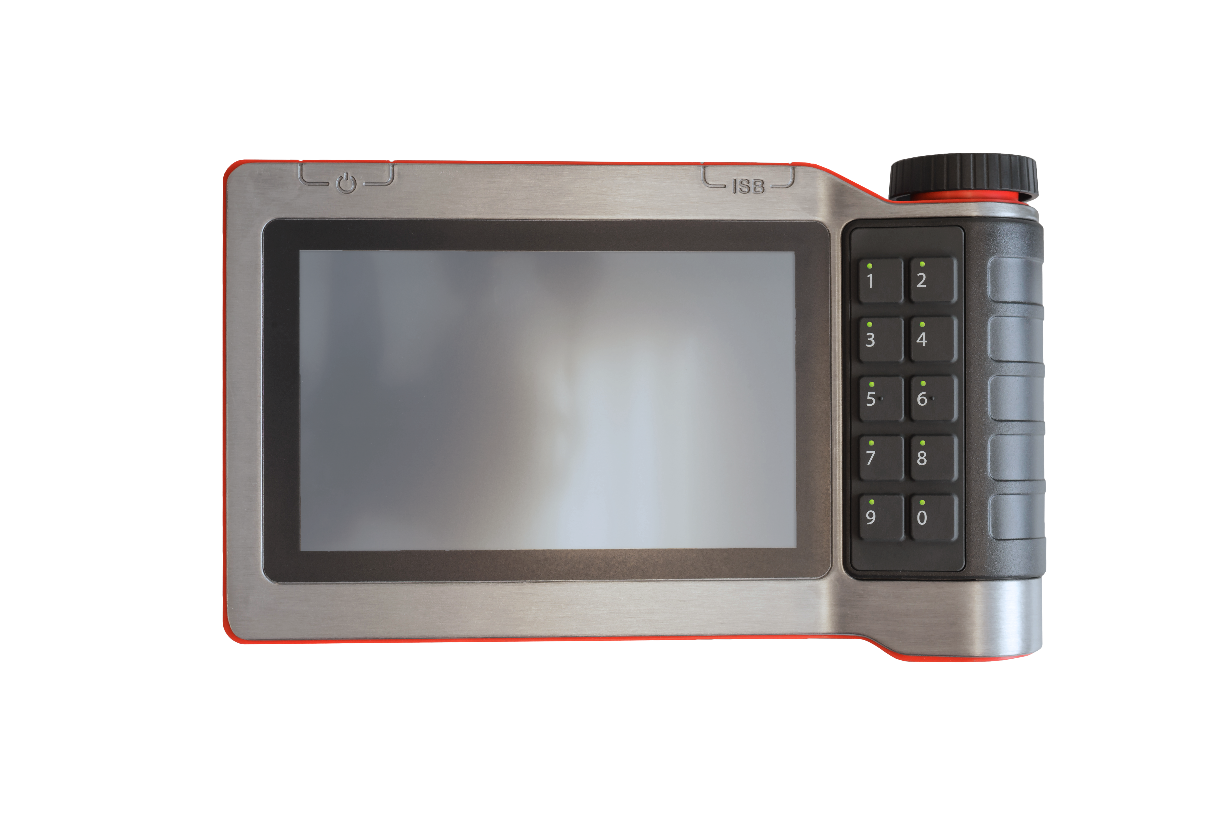
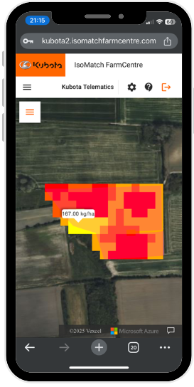

In-house Connected Solutions
IsoMatch FarmCentre
ISOBUS Implements
Implement gateway or terminal
Terminal
Licenses
KvG brands spreaders, sprayers, seeder and baler
IsoMatch Tellus GO+
IsoMatch Tellus PRO
Terminal
Licenses
Kubota Sync
IsoMatch GEO-VR
IsoMatch GEOCONTROL
Connected User
IsoMatch FarmCentre
Enjoy the IsoMatch FarmCentre journey!
Starter kit with 4G dongle, 2 year of license, data and MyDataPlant voucher

Slide 40
What Makes us Unique?
IsoMatch FarmCentre
Easy & Intuitive
KvG platform for Machinery & Agronomy
3rd party compatibility
(isoxml)
Integrated devices and systems

Slide 41
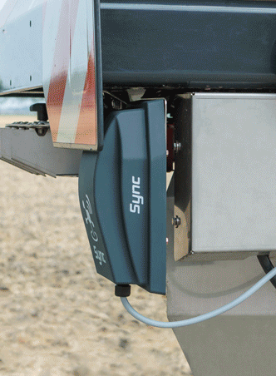
Implements Online
Kubota Sync
Kubota Sync is a connectivity device installed in Kubota ISOBUS implements. This gateway allows the connection of the implements to the cloud. In this way, it will be possible to use remote service (integrated in K-OBD ACE) or IsoMatch FarmCentre.
It allows also to connect to the implement via Bluetooth and interact with them with dedicated applications like the Spreaders Chart App.

Slide 42
Cloud Connection
Kubota Sync
Physical connection
ISOBUS terminals.
Kubota ISOBUS implements.
Remote connection
Remote service (integrated in K-OBD ACE) via cloud
IsoMatch FarmCentre via cloud
Implement Apps** via Bluetooth

Slide 43
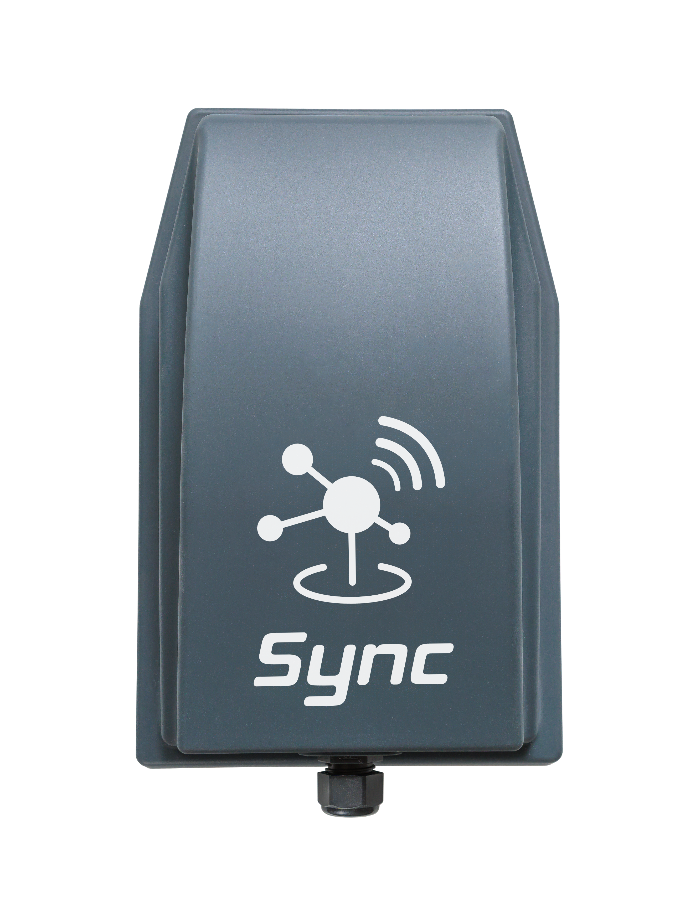
Benefits
Kubota Sync
Kubota Sync ensures smooth connectivity and farming data flow between Kubota ISOBUS implements and digital tools.
Always Connected
Kubota Sync ensures seamless
connectivity to online services, with smooth data transfer to the cloud.
Remote Service
Technicians can resolve issues promptly using service tools with remote connection.
Maximize Profitability and Growth
Data analysis of the KPI form the implements
Tracking & Reporting
It allows real-time tracking of operations and diagnostic
codes, offering detailed reporting and secure task data storage.
New Features and Enhanced Safety
Enjoy Kubota Synchronization with implement apps**, precise tracking, and geofencing. Benefit from automated documentation, enhanced safety, and precise task planning.
Terminal Connectivity
Connect your Tellus Terminal via Kubota Sync for access to digital tools directly on your terminal.

Slide 44
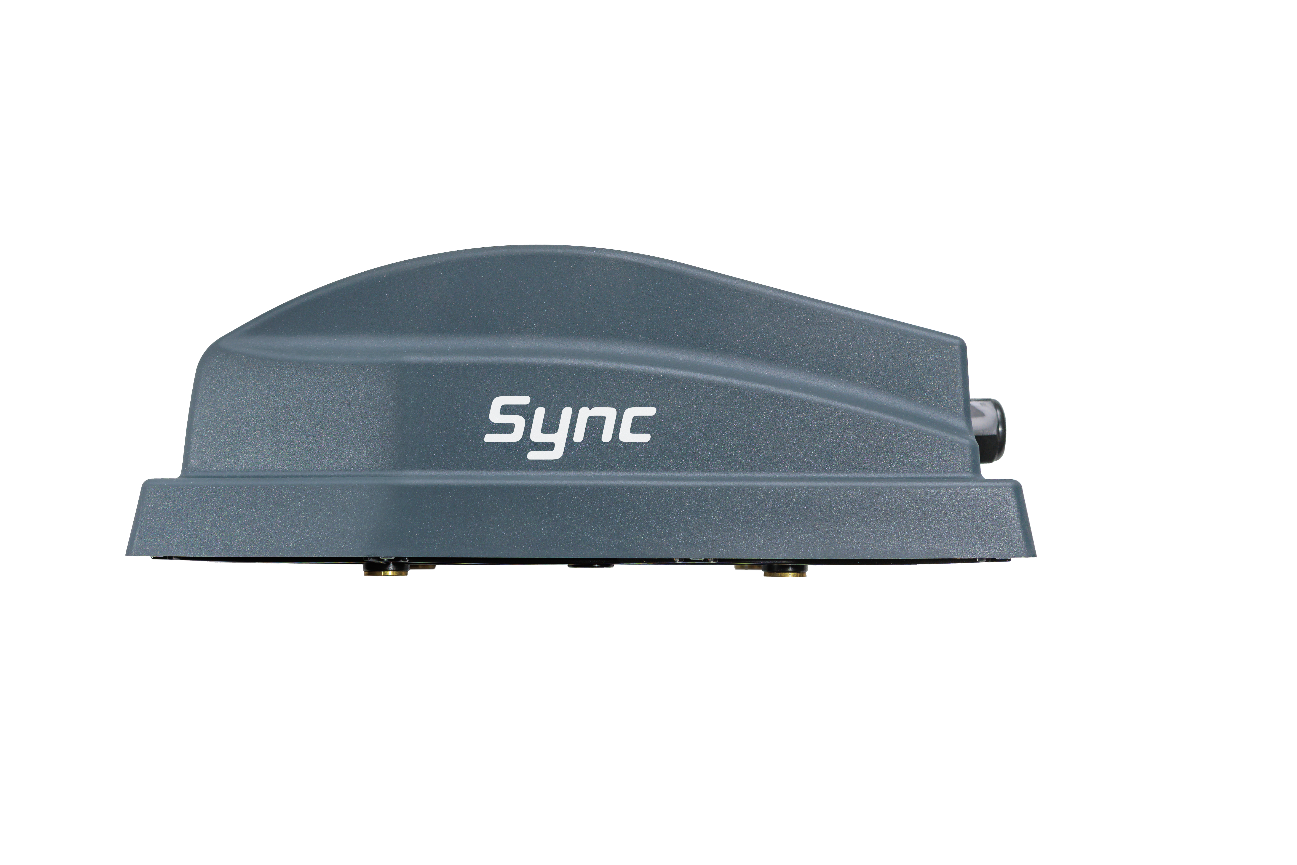




Features
Kubota Sync
ENABLING THE TOOLS
Tracking & Reporting
Data insights
Complete ecosystem
Machine insights with IsoMatch FarmCentre.
GEOfence when implement is OFF.
Always connected to the implement.
Independent of tractor brand.
Remote service through implement dealer.
Seamless data collection.
Dedicated platforms for farmers and dealers.
IsoMatch FarmCentre
Remote connection from any location at any time Real-time visibility into tasks, alert history and operational values.
Remote Service
Kubota Sync on the implement enables remote diagnostics, monitoring machine health, timely replacement of parts and efficient troubleshooting.

Slide 45
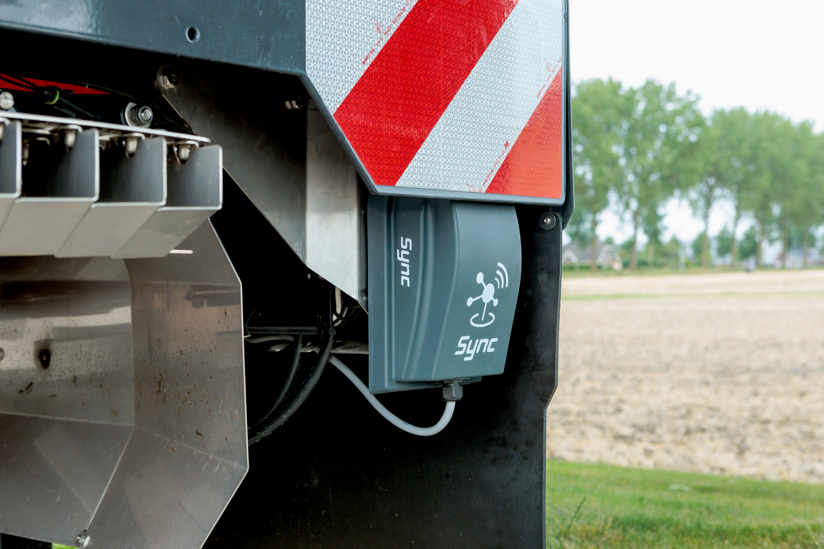
Activation
Kubota Sync
Kubota Sync is delivered together with the corresponding implement where it is fitted. The gateway includes a SIM card with 2 years of data and a license for IsoMatch FarmCentre valid also for 2 years. When the implement is delivered, some steps have to take place to activate the gateway and to consent the use of customer data and register the Kubota Sync into the IsoMatch FarmCentre account.

Slide 46
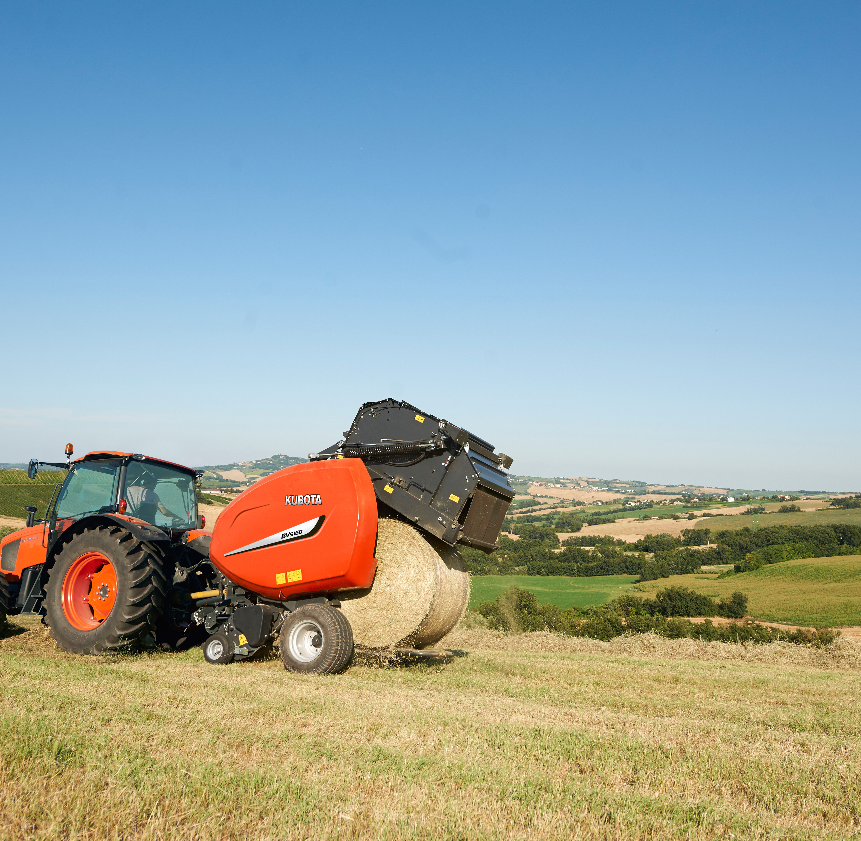
Market introduction
Kubota Sync
Target is to fit Kubota Sync in all ISOBUS implements from September 2025. This will be done in a ramp-up process, starting in September 2024 with Kverneland and Vicon implements. Kubota implements will start this process in January 2025.
Due to technical limitations related to data sharing, Kubota Sync will not be commercialized in some countries.

Slide 47
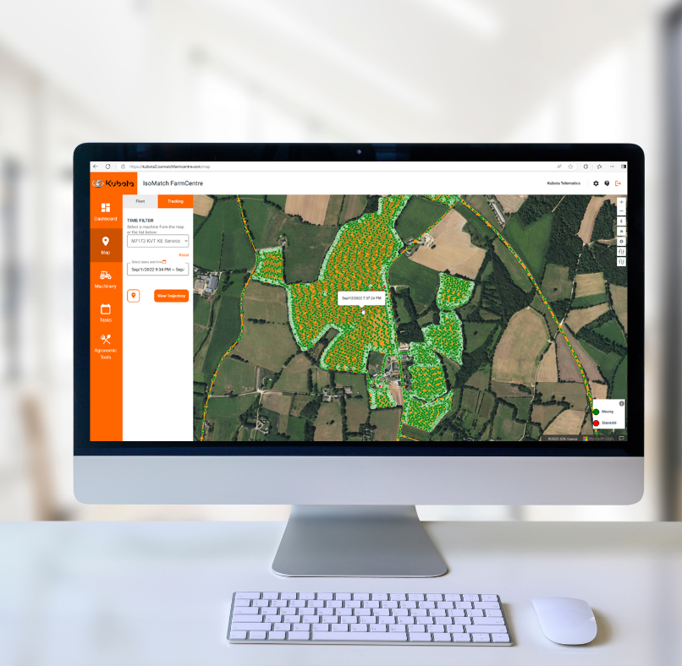
Dashboard Overview
IsoMatch FarmCentre
Full overview in one page where the user finds insights about his connected machines.
Map – see in real-time the status ON/OFF, location and terminals linked to implements.
My Machinery – counter and list of active / inactive machines.
Tasks – planned and performed counter with list of performed ones.
Notifications – about machinery, geofence and tasks.

Slide 48
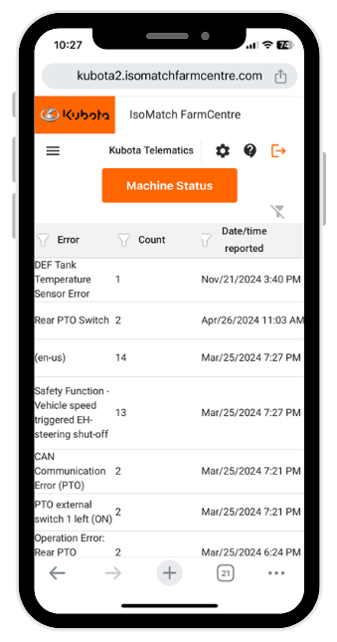
Machinery
IsoMatch FarmCentre
Inventory of machines where is possible to see for each one:
Status of the implement (active/inactive), total counter and task counter.
Gateway used to connect to the cloud.
Machine parameters status.
Task performance.
Other machine data to verify the setup.

Slide 49
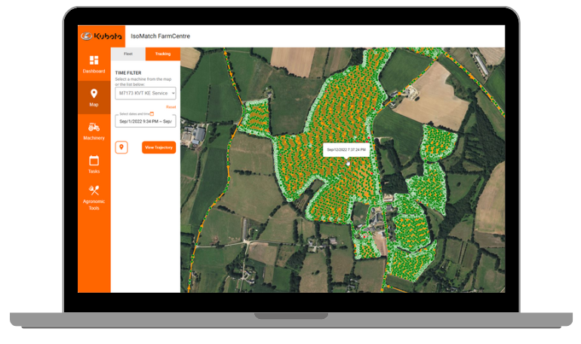
Map
IsoMatch FarmCentre
Map helps the user to do specific machinery control such as:
Geofence – setting first the home coordinates and then establishing a radio from 1 to 50 km. Notification is issued when a driver is out.
Tracking – ability to see the exact path of a machine from any day and any time within 2 months.
Time stamp - For each track point it is possible to check the time stamp.
For each one of the points reproduced in the track of the implement it is possible to check the time stamp.
Trajectory shows the direction and the places where the machine was moving or when it was stopped.

Slide 50
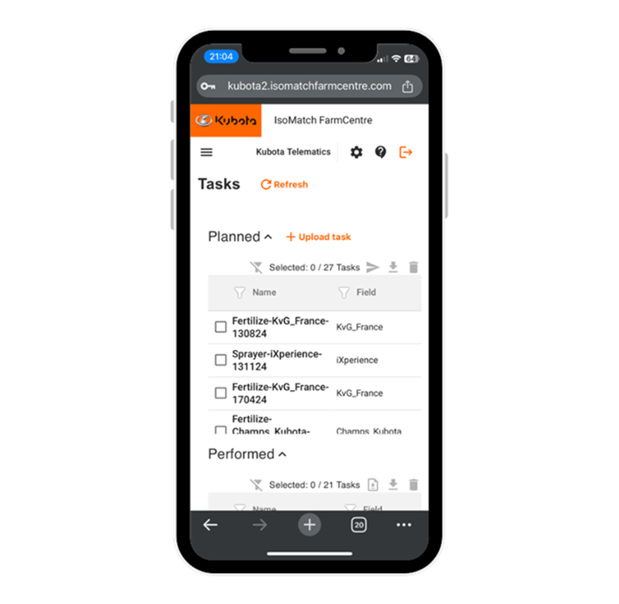
Tasks
IsoMatch FarmCentre
Easy tasks management having the next options:
Upload tasks – with integrated FMIS, or from external sources.
Send tasks to terminals – using the cloud as a hub.
Collect performed tasks – sending them from terminals to the cloud.
Download the tasks – download the tasks in ISOXML format, Excel or get a PDF report.

Slide 51
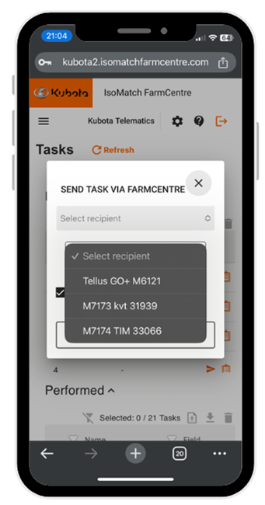
Tasks
IsoMatch FarmCentre
If a task uploaded includes multiple fields, IsoMatch FarmCentre split them in the application. It is possible to send simultaneously multiple tasks to the terminal in one go.
When the task is created in MyDataPlant application, it is sent directly to the Planned Tasks folder of IsoMatch FarmCentre.

Slide 52
Notifications & Alerts
IsoMatch FarmCentre
Be always automatically informed about your machinery events such as incidents, tasks files or if is out the desired location.
Received task by connected terminals – be informed on when a planned task has arrived to the corresponding terminal.
Geofence – get notified when a machine is out of the area established by fleet owner.
DTCs – know and check which have been the errors produced on the machinery.

Slide 53
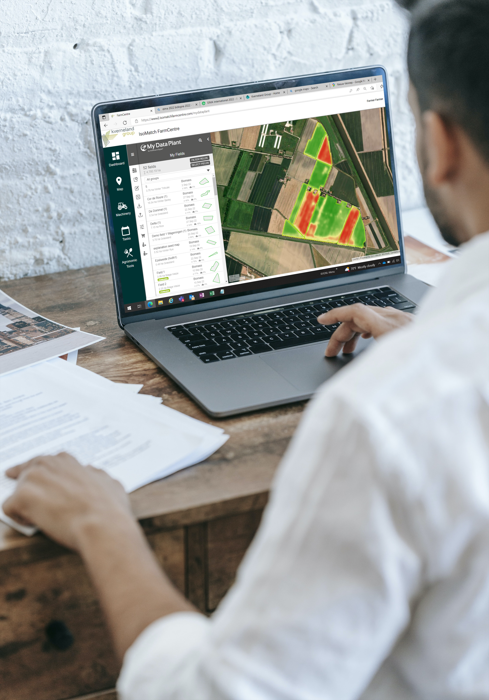
MyDataPlant
IsoMatch FarmCentre
Integrated external software to reach the specific agricultural needs of each geography, such as FMIS.
MyDataPlant
Easy creation of Variable Rate maps for site-specific applications.
MyDataPlant is an add-on that allows customer to build prescription maps and upload them to the cloud. Via MyDataPlant customer can analyse the biomass development of the crops, and based on it create the corresponding prescription maps. User can always modify the prescription maps created. The starter package allows to use MyDataPlant for 90 days in up to 5 fields and the ability to create up to 15 prescription maps.

Slide 54

MyDataPlant
IsoMatch FarmCentre
Prices
BIOMASS
MAPS
SEED
MAPS
Firstly, decide on how many hectares you wish to monitor with biomass mapping, the greater the area the cheaper the cost per hectare.
Biomass maps are a prerequisite for all other modules.
Cost /ha: 2.00 €
fertilization
MAPS
Biomass maps are the foundation of each of the other map options, so you need to purchase these first. In the second step, select and purchase the prescription map that you need (seedier, fertilizer or crop protection) .
Cost /ha: 2.00 €
Total area | Cost / ha
< 500 ha | 4.00 €
500 - 1.000 ha | 3.30 €
1.000 - 5.000 ha | 2.70 €
> 5000 ha | POA
Crop protection
MAPS
All prices mentioned are per year with unlimited number of downloads.
Cost /ha: 2.00 €

Slide 55
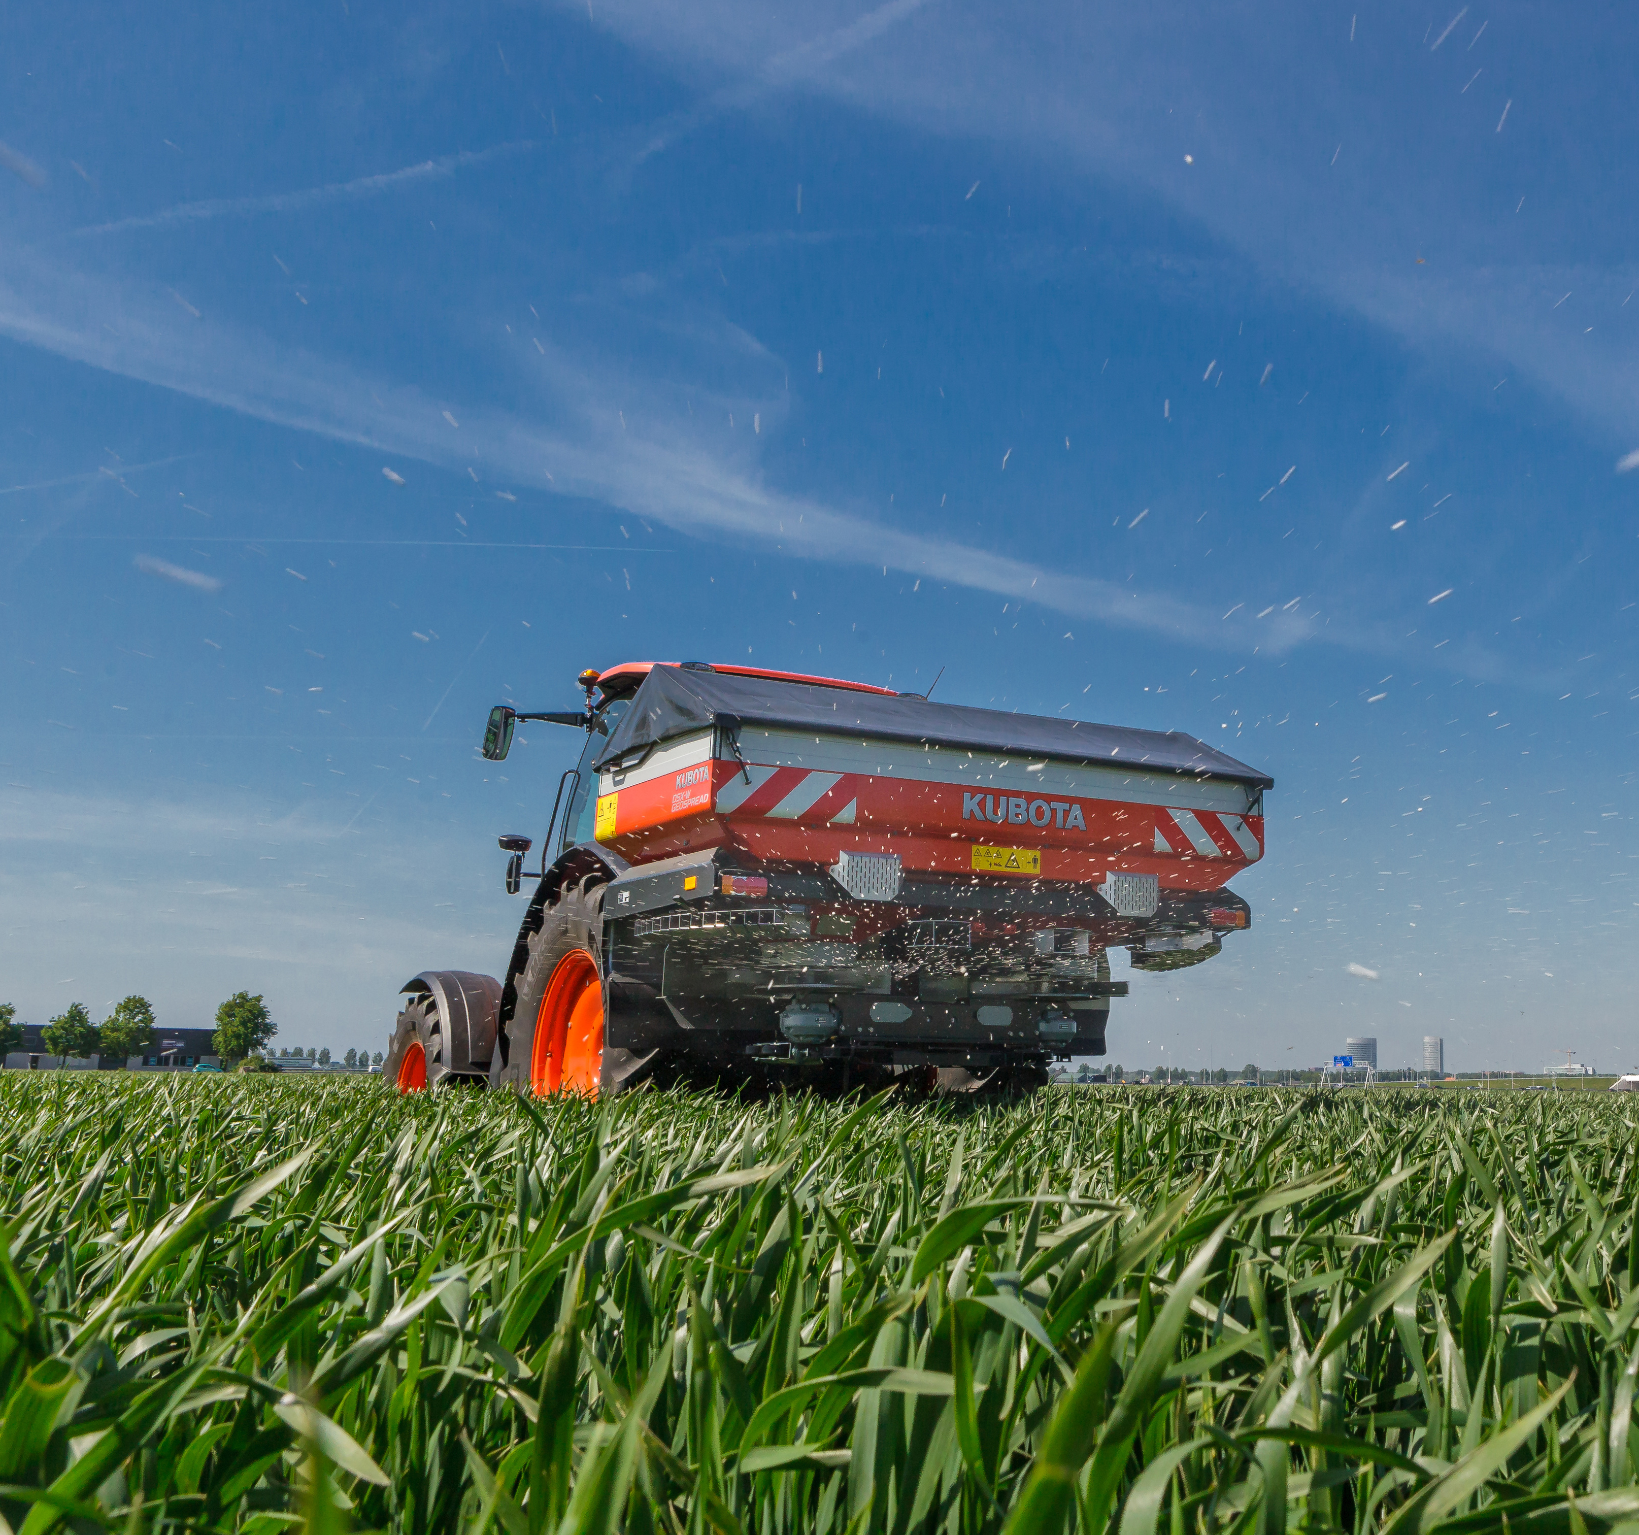
Analytics
IsoMatch FarmCentre
Place to observe how some machine parameters have performed along the desired period.
Calendar – with populated days that have data.
Parameters – possibility to compare 2 at the same time.
Bar or Line – type of chart.
Averages and Totals available.
Download reports – in PDF and Excel format.

Slide 56
Reports
IsoMatch FarmCentre
Reports of the tasks and machines can be downloaded in multiple formats.
Tasks
Available in PDF
Available in Excel
For 1 task
For multiple tasks
Machinery
Available in PDF
Available in Excel

Slide 57
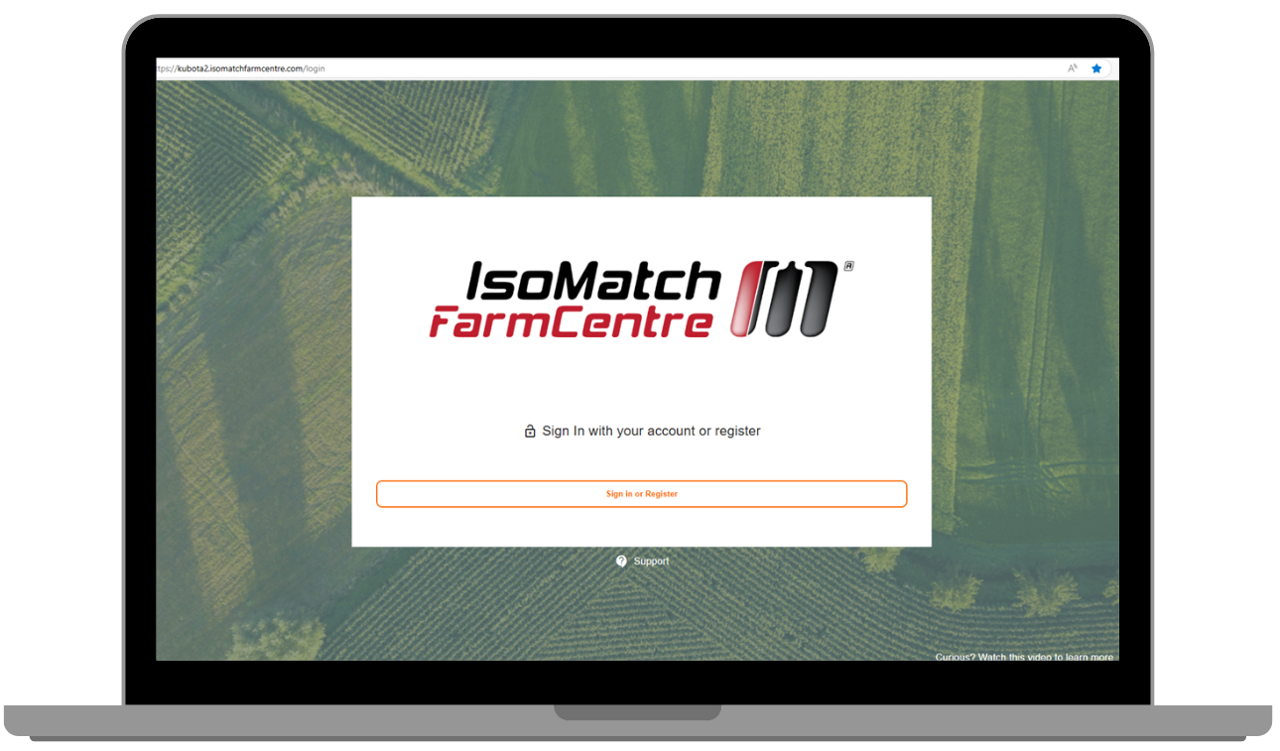
Register a Terminal
IsoMatch FarmCentre
Once your IsoMatch FarmCentre account is active, the next step is to link your terminals or Kubota Sync gateways.
Go to Settings and click to add the corresponding device.
Introduce the MAC address
Check in the terminal that the cloud icon of IsoMatch FarmCentre is green
Check in the dashboard that the Kubota Sync appears with its implement

Slide 58
Machine Connected
IsoMatch FarmCentre
Once the terminals or gateways are connected to the IsoMatch FarmCentre cloud, the connection of the implements is done automatically. When an implement is connected to a terminal that is "on-line", the implement data is also transmitted to the cloud. In case the connection is lost, the terminals store all the information sending it to the cloud when the connection is re-established.

Slide 59




Activation Flow
Kubota Sync
Machine delivery
Machine is delivered to the dealer. Kubota Sync is fitted and installed in the machine.
Document preparation
Dealer downloads and prints the warranty conditions and data contract from Quest.

Slide 60

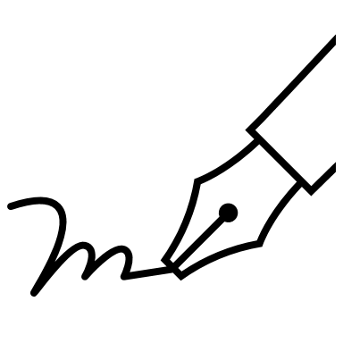


Machine delivery
Machine is delivered to the farmer and final setup is done by the dealer.
Customer’s signature
Customer is asked to sign the delivery documents with the warranty conditions and the data contract to fulfil the GDPR requirements.
Accept
Decline
Customer signs and accepts the data contract and the dealer sends it to the Kubota Sync Support mailbox. Kubota Sync is active and starts sending data to the cloud.
Customer does not accept to share data. Contract with the decline request has to be sent to the Kubota Sync Support mailbox.

Slide 61

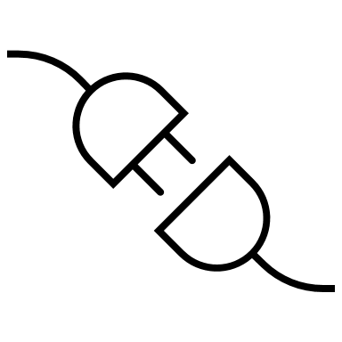



Log in
De-activation
Customer is asked to create an account in MyKverneland or MyVicon landing sites.
Within 5 working days from receiving the decline from customer, Kubota Sync is de-activated.
Registration
Once logged in the landing site, customer can access to IsoMatch FarmCentre and register the Kubota Sync device. Implement will appear automatically.
Usage
Customer gets machine information in its IsoMatch FarmCentre account and can request remote service when necessary.
Renewal
After two years customer can access to the Terrako Marketplace to purchase an IsoMatch FarmCentre license renewal. As long as the customer account is active, Kubota Sync will continue to send data to the cloud.

Slide 62
Introduction plan – Phase 1
Kubota Sync
IMPLEMENT | MODEL | FACTORY | INTRODUCTION
SPREADERS | All EDW3 models | KvG Nieuw-Vennep | September 2024
SPRAYERS | T6 | KvG Nieuw-Vennep | September 2024
PRECISION SEEDER | Optima TF Profi | KvG Soest | September 2024
POWER HARROW | Rotago | KvG Soest | September 2024
PLOUGH | i-Plogh | KvG Klepp | September 2024
DISC MOWER | EXTRA 7100 | KvG Kerteminde | October 2024
BALE-WRAPER | FastBale Premium | KvG Ravenna | January 2025
BALER | VariBale / FixBale | KvG Ravenna | January 2025
Subject to Factory confirmation

Slide 63
Introduction plan – Phase 2
Kubota Sync
IMPLEMENT | MODEL | FACTORY | INTRODUCTION
SPRAYERS | iXdrive S6 iXter T3 / iXter T4 / iXter B | KvG Nieuw-Vennep | January 2025
PRECISION SEEDER | Optima V / Optima R / Optima F / Monopill / Unicorn | KvG Soest | January 2025
SEED DRILL | u-drill / e-drill / Satio F / f-drill | KvG Soest | January 2025
CULTIVATOR | i-Tiller | KvG Les Landes | January 2025
PLOUGH | PW / RW | KvG Klepp | January 2025
Subject to Factory confirmation

Slide 64
Introduction plan – Phase 3
Kubota Sync
IMPLEMENT | MODEL | FACTORY | INTRODUCTION
SPRAYERS | iXtra Life iXtra A | KvG Nieuw-Vennep | September 2025
PRECISION SEEDER | Optima RS | KvG Soest | September 2025
SEED DRILL | TS-drill | KvG Soest | September 2025
MECHANICAL WEEDER | Onyx | KvG Les Landes | September 2025
Subject to Factory confirmation

Slide 65
Market Availability
Kubota Sync
Kubota Sync is available in all markets where Kverneland group distributes ISOBUS implements except the following ones:
America
Canada
United States
Mexico
Brazil
Paraguay
Chile
Uruguay
Argentina
CIS
Uzbekistan
Azerbaijan
Belarus
Russian Federation
Far East
Korea
Taiwan
Vietnam
India
Malaysia
Singapore
Thailand
China
Near East
Israel
United Arab Emirates
Saudi Arabia

